Slide 1
Exploratory Data Analysis:
Brazil House and Apartment Listings
Featuring Neural Network Regression
Vince Rian M. Misalucha
https://youtu.be/bfIedEVtKQM

Slide 2
TABLE OF CONTENTS
INTRODUCTION
LOCATION
01
02
TIME
REGRESSION
03
04
CLOSING
05
Objective and Overall Data Description
Location analysis and the value that comes with it
The state of property value throughout time
Neural Network Regression
Conclusion and Recommendations

Slide 3
INTRODUCTION

Slide 4
Objectives
Theme: Provide insights relevant to a potential customer
Analyze the location of Brazil real-estates
Showcase the trend of real-estate value
Forecast new real-estate
Provide recommendations for the stakeholders

Slide 5


ABOUT THE DATA
The BigQuery dataset Brazil Real Estate listings is from Properati a competitive marketplace for Latin America real estate. Listings from 2015 to 2018.

Slide 6
CLEANING THE BIGQUERY DATA
1
2
3
4
5
SELECT BRAZIL DATASET
REMOVE REDUNDANCIES
ALLEVIATE/DELETE NULL VALUES
UNIQUENESS
EXPORT MAX ALLOWED

Slide 7
DATA: CRITERIA AND CONDITIONS
Focus: Sell operation type
Granularity: Monthly
ID should not be nullable, assuming it as validation between the market and buyer
Other non-nullable: Price, Property Type, Coordinates, Surface Area, Place, Floor, and Rooms.

Slide 8
DATA: CRITERIA AND CONDITIONS
Check uniqueness of categorical values
Uniformity and Usability all throughout the EDA and NN Regression
Limitation: 16,000 records per export

Slide 9
DATA: CRITERIA AND CONDITIONS
SELECT id, operation, property_type, place_name, state_name, surface_covered_in_m2, floor, rooms, price
FROM `properati-data-public.properties_br.properties_sell_201N`
WHERE
id IS NOT NULL AND
property_type IS NOT NULL AND
place_name IS NOT NULL AND
state_name IS NOT NULL AND
surface_covered_in_m2 IS NOT NULL AND
floor IS NOT NULL AND
rooms IS NOT NULL AND
price IS NOT NULL
Additional Data Processing: Jupyter Files

Slide 10
MAIN DATA SELECTED
Data: Brazil Listings of House and Apartment
Time Frame: January 2015 to February 2018
Records: 170,000+
Features:
ID
Operation
Place and State name
Longitude and Latitude
Surface Area in Sq. Meters
Rooms and Floors
Price

Slide 11
LOCATION
Choosing from the Current Listings (Feb 2018)

Slide 12
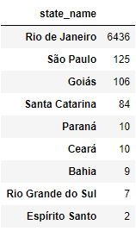
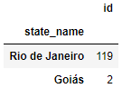
RAW NUMBERS: VOLUME PER STATE
Apartment
House
OPERATION TYPE: SELL

Slide 13
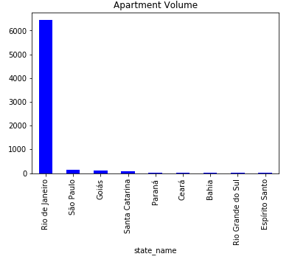
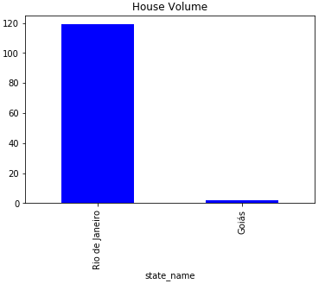
RAW NUMBERS: VOLUME PER STATE
OPERATION TYPE: SELL

Slide 14
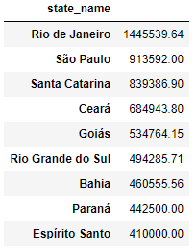
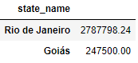
RAW NUMBERS: PRICE AVG PER STATE
Apartment
House
OPERATION TYPE: SELL

Slide 15
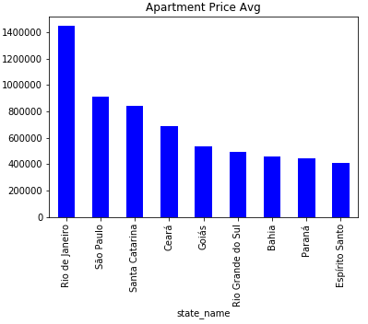
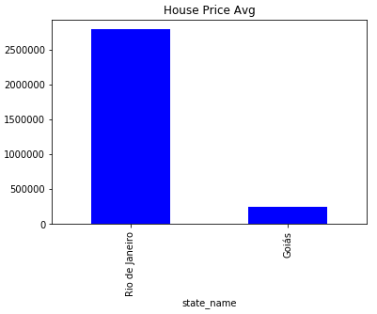
RAW NUMBERS: PRICE AVG PER STATE
OPERATION TYPE: SELL

Slide 16
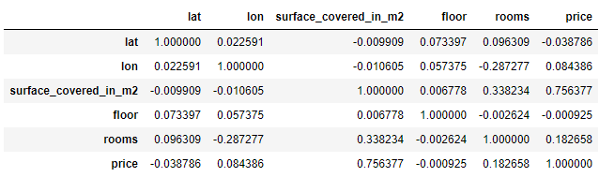
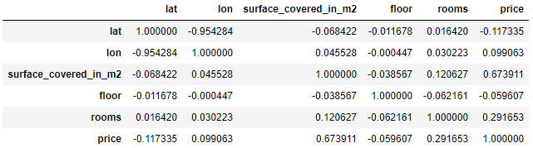
CORRELATION OF NUMERICAL FEATURES
Apartment
House
OPERATION TYPE: SELL

Slide 17
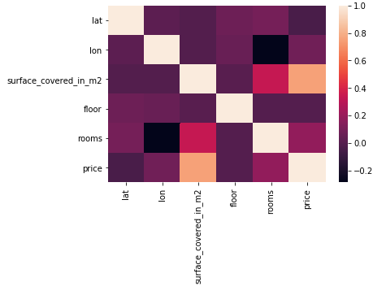
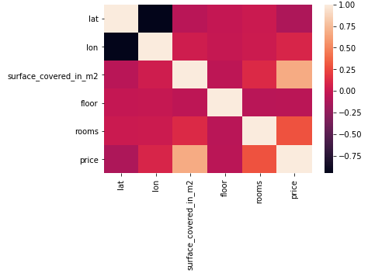
CORRELATION OF NUMERICAL FEATURES
Apartment
House
Foundational Idea: Consider Surface Covered in SqM as a good Price indicator
OPERATION TYPE: SELL

Slide 18
INTERACTIVE FOLIUM GEO: APARTMENTS
LEGEND
Data: Listing of Apartments in Brazil (February 2018)
Color: Price Based (Ascending)
1st Quartile
2nd Quartile
3rd Quartile
4th Quartile
Size of Markers: Corresponds to Area in Sq. Meters
OPERATION TYPE: SELL

Slide 19
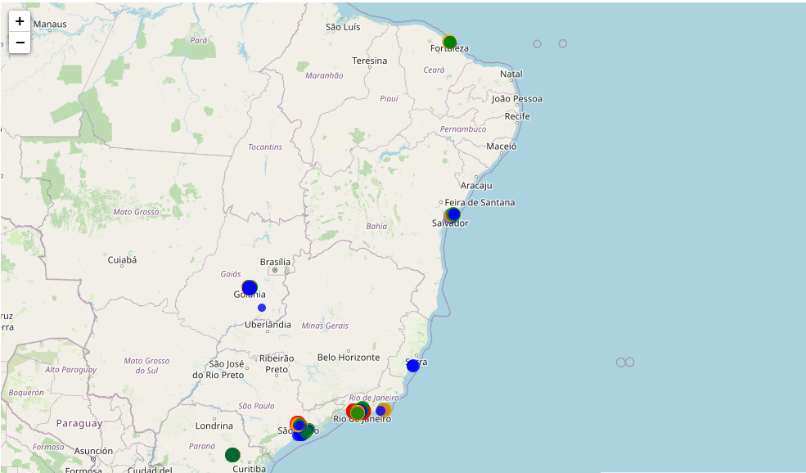
INTERACTIVE FOLIUM GEO: APARTMENTS
Brazil
OPERATION TYPE: SELL

Slide 20
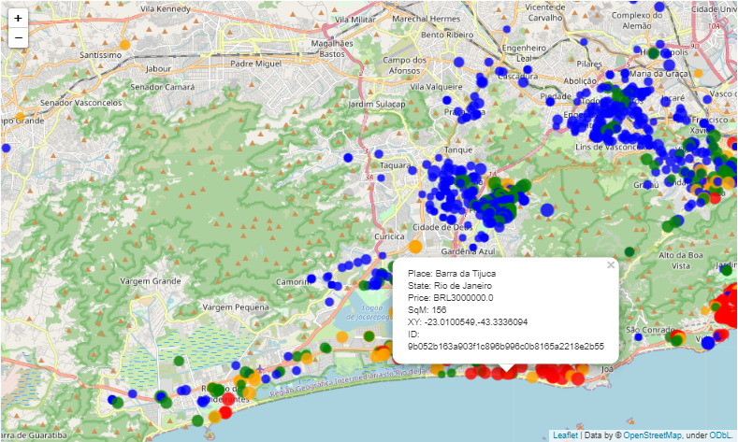
INTERACTIVE FOLIUM GEO: APARTMENTS
Brazil
OPERATION TYPE: SELL

Slide 21
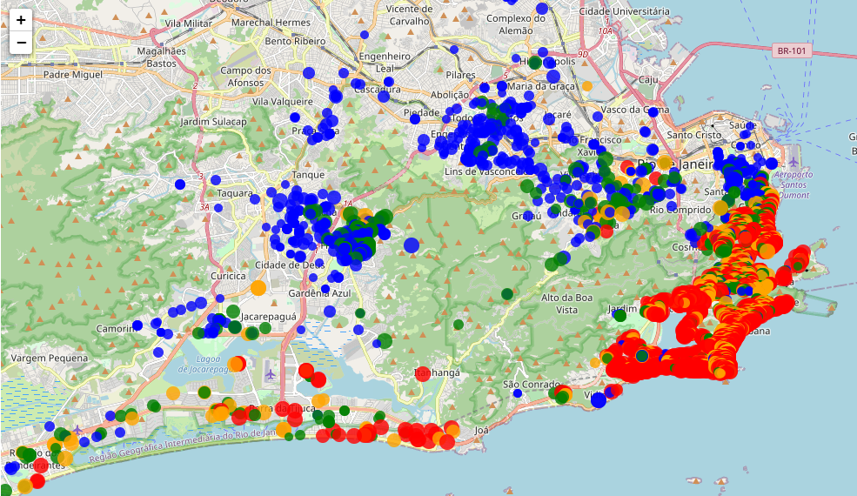
INTERACTIVE FOLIUM GEO: APARTMENTS
Rio de Janeiro
OPERATION TYPE: SELL

Slide 22
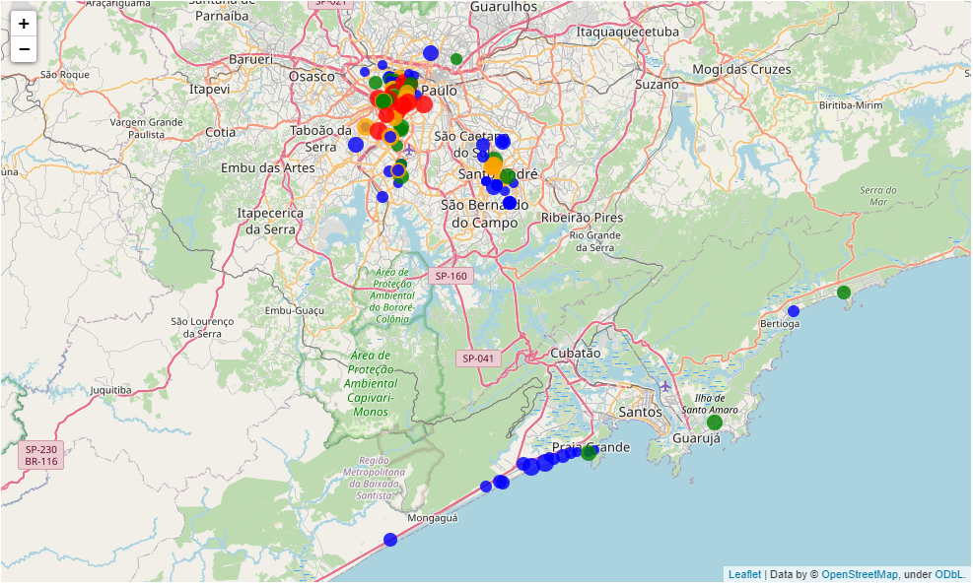
INTERACTIVE FOLIUM MAP: APARTMENTS
São Paulo
OPERATION TYPE: SELL

Slide 23
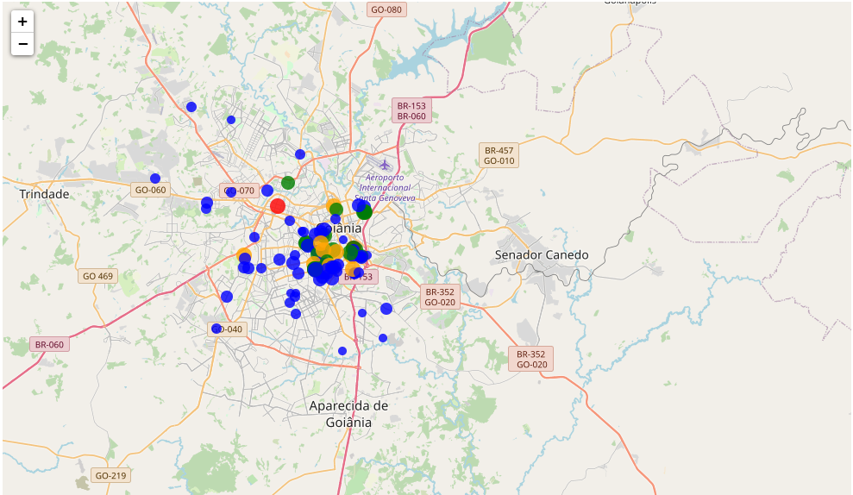
INTERACTIVE FOLIUM MAP: APARTMENTS
Goiás
OPERATION TYPE: SELL

Slide 24
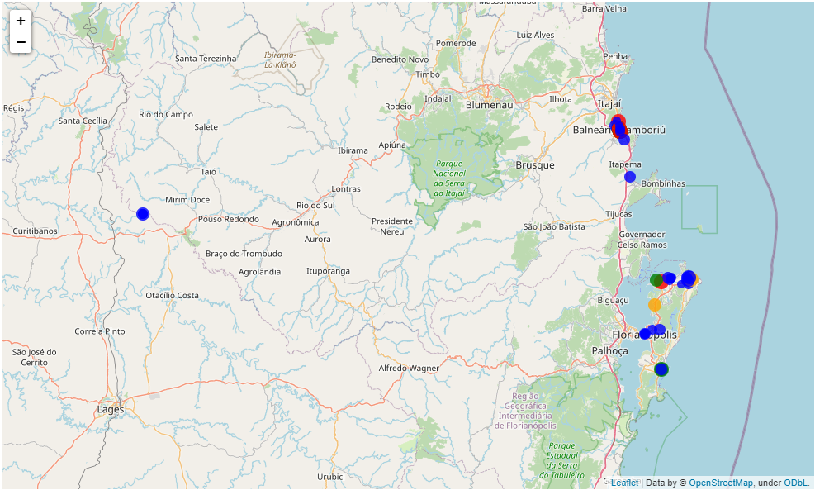
INTERACTIVE FOLIUM MAP: APARTMENTS
Santa Catarina
OPERATION TYPE: SELL

Slide 25
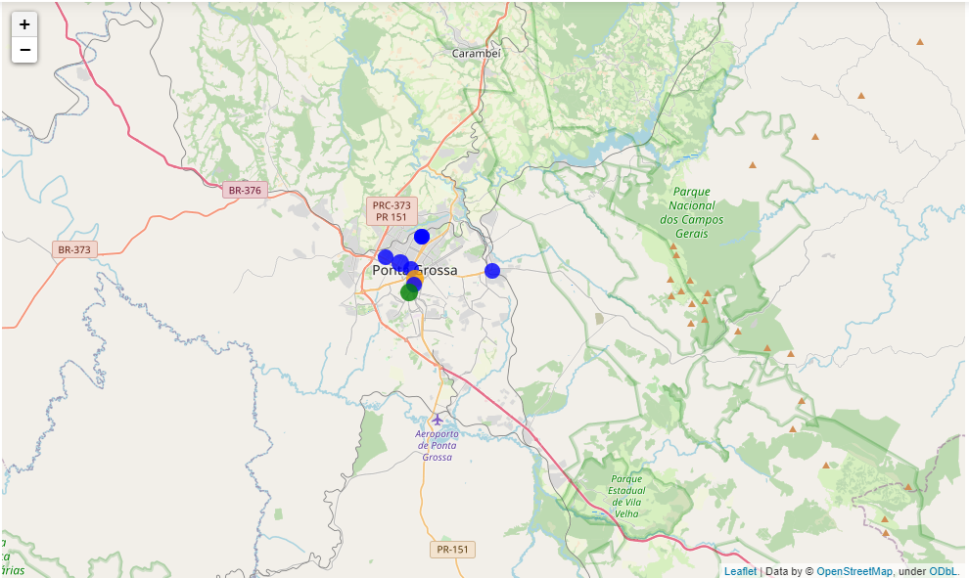
INTERACTIVE FOLIUM MAP: APARTMENTS
Paraná
OPERATION TYPE: SELL

Slide 26
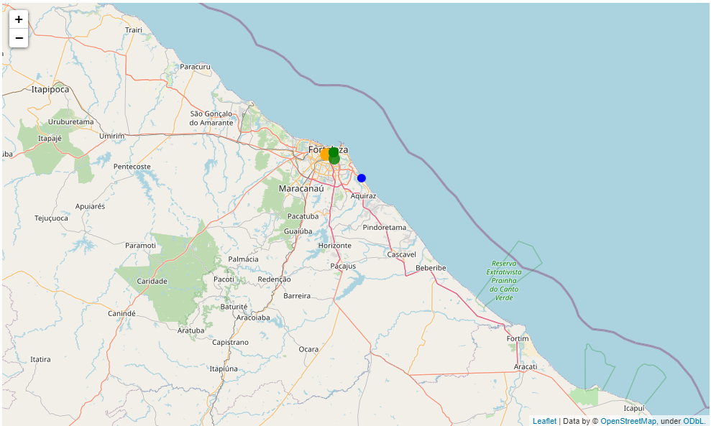
INTERACTIVE FOLIUM MAP: APARTMENTS
Ceará
OPERATION TYPE: SELL

Slide 27
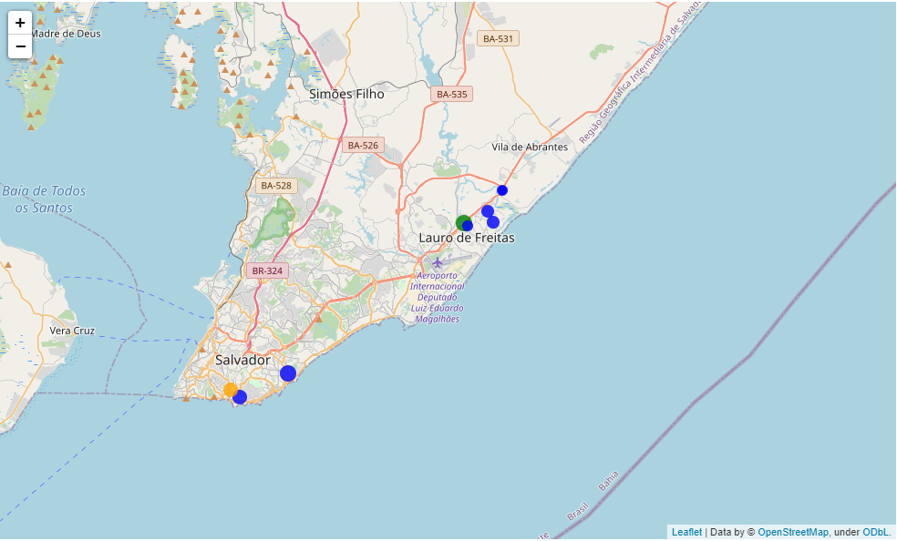
INTERACTIVE FOLIUM MAP: APARTMENTS
Bahia
OPERATION TYPE: SELL

Slide 28
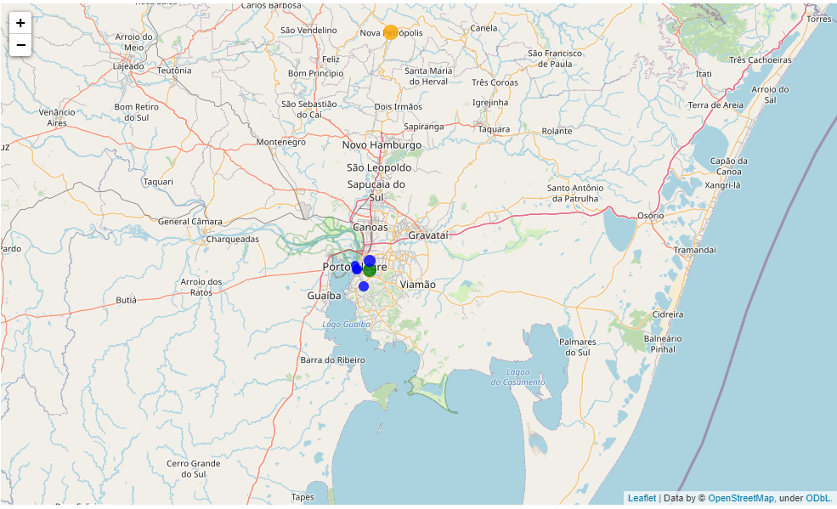
INTERACTIVE FOLIUM MAP: APARTMENTS
Rio Grande do Sul
OPERATION TYPE: SELL

Slide 29
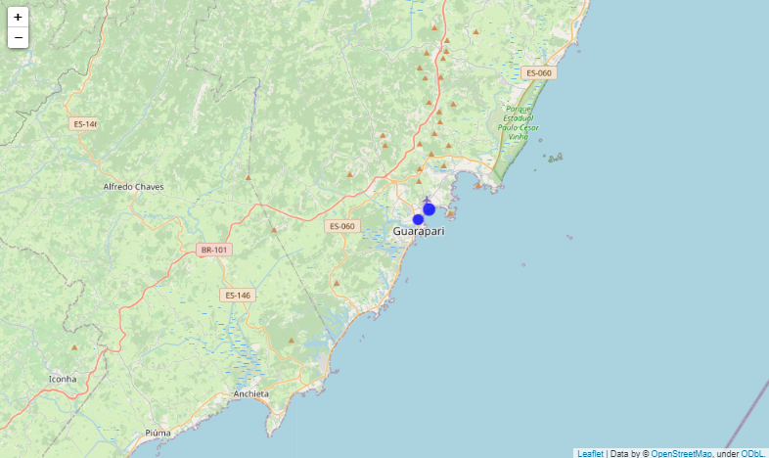
INTERACTIVE FOLIUM MAP: APARTMENTS
Espírito Santo
OPERATION TYPE: SELL

Slide 30
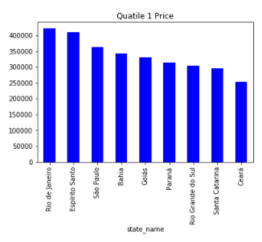
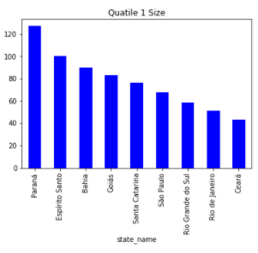
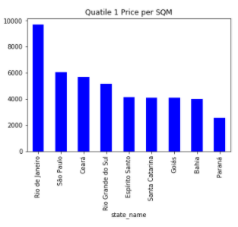
SUPPORTING TABLES: QUARTILE 1
OPERATION TYPE: SELL

Slide 31
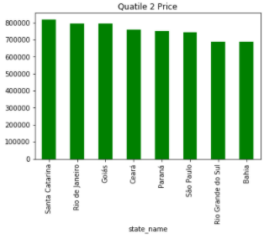
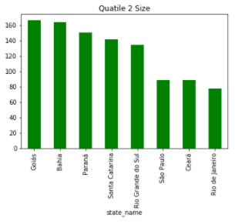
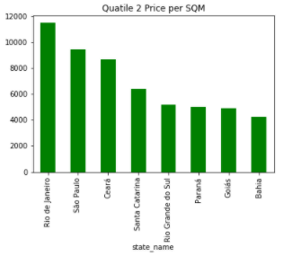
SUPPORTING TABLES: QUARTILE 2
OPERATION TYPE: SELL

Slide 32
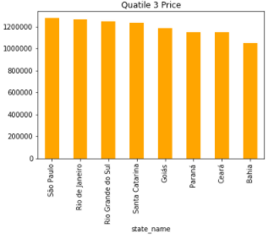
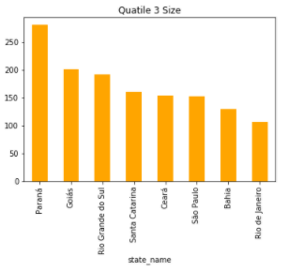
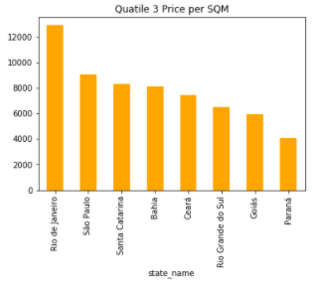
SUPPORTING TABLES: QUARTILE 3
OPERATION TYPE: SELL

Slide 33
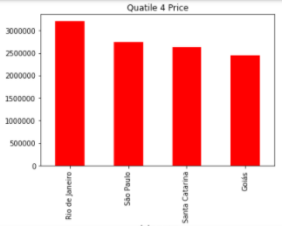
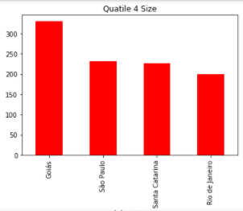
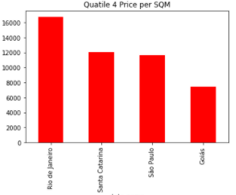
SUPPORTING TABLES: QUARTILE 3
OPERATION TYPE: SELL

Slide 34
Apartment Insights
Paraná is the best state for buying apartments in terms of getting the most spacious with the least amount of money. Consistently in first three price quartiles, Paraná is among the lowest price per sq. meter and among the most spacious. In fact, Paraná ranked last in price per sq. meter and first in surface per sq. meter. However the state lacks variety.
Rio de Janeiro is an intriguing state of seeking investments, dominates the market in terms of volume especially the south-eastern coastline that is primarily populated by Q4 apartments. Observing the folium map, the price and volume of apartments are increasing as it approaches the south-eastern coastline of Rio de Janeiro.
OPERATION TYPE: SELL

Slide 35
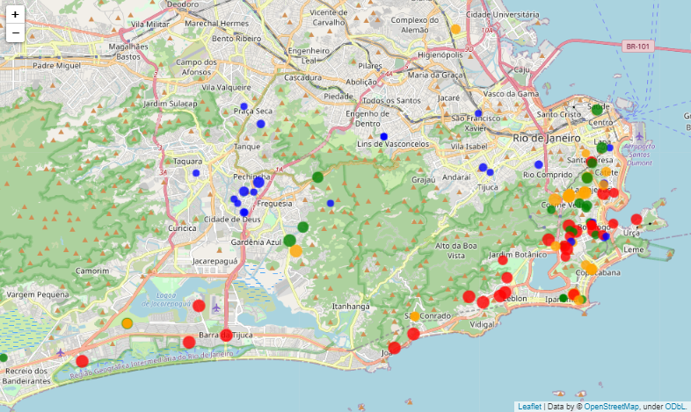
INTERACTIVE FOLIUM MAP: HOUSES
Rio de Janeiro
OPERATION TYPE: SELL

Slide 36
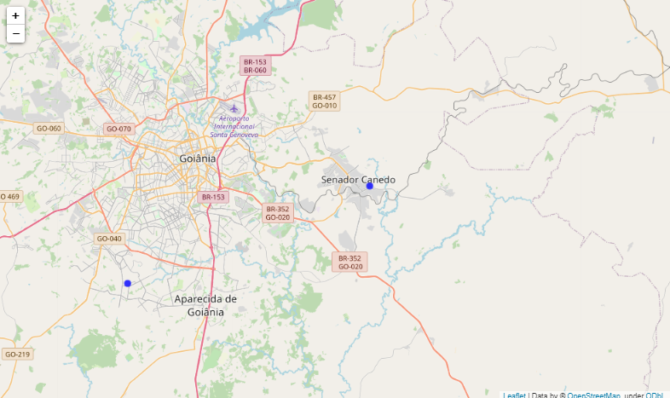
INTERACTIVE FOLIUM MAP: HOUSES
Goiás
OPERATION TYPE: SELL

Slide 37
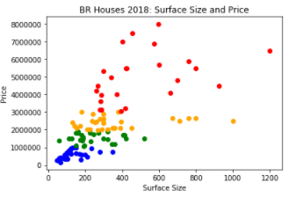
SUPPORTING SCATTER PLOT
OPERATION TYPE: SELL

Slide 38
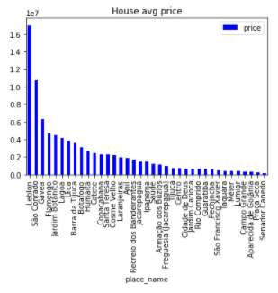
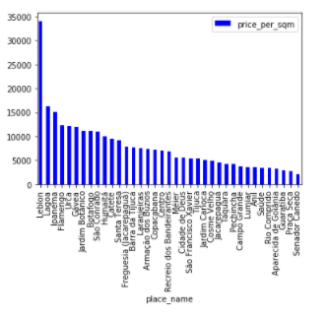
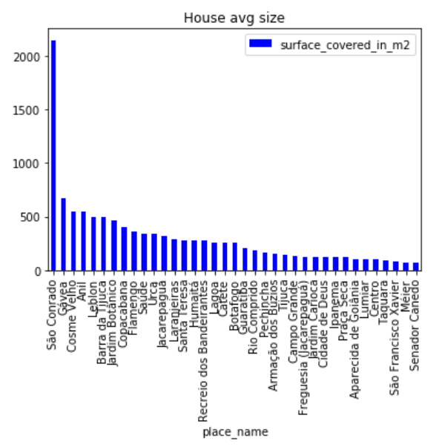
SUPPORTING HISTOGRAMS
OPERATION TYPE: SELL

Slide 39
Housing Insights
Generally, an apartment is the more expensive form of investment due to its volume indicating a strong demand and a better average price per sq. meters.
Housing listings is identical to the Apartment listings’ price relationship on other features. In fact, the housing market follows the trend south-eastern coastline trend of Rio de Janeiro rather than utilizing for a larger space in less urban areas. This is based on the geospatial maps and supporting histograms.
OPERATION TYPE: SELL

Slide 40
TIME
Finding the best time to purchase

Slide 41
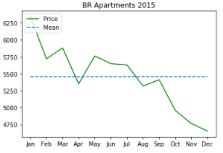
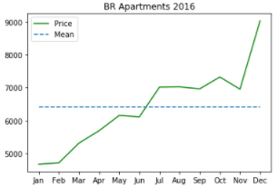
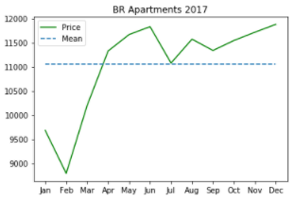
MARKET SEASONALITY TREND
Apartments
Price: Average Price per Sq. Meters Covered by the Real Estate
OPERATION TYPE: SELL

Slide 42
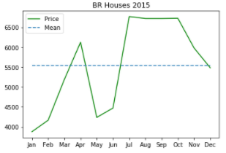
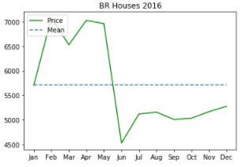
MARKET SEASONALITY TREND
Houses
Price: Average Price per Sq. Meters Covered by the Real Estate
OPERATION TYPE: SELL

Slide 43
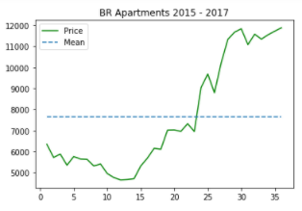
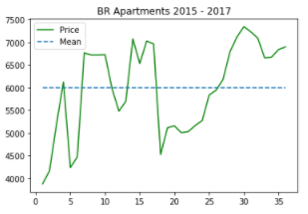
3 YEAR GROWTH OF THE MARKET
Apartments
Houses
Price: Price per Sq. Meters Covered by the Real Estate
OPERATION TYPE: SELL

Slide 44
23.26%
21.16%
Apartment Market
CAGR
Housing Market
CAGR
Compound Annual Growth Rate of the apartment market from 2015 to 2017 in terms of Average Market Price per Sq. Meter
Compound Annual Growth Rate of the housing market from 2015 to 2017 in terms of Average Market Price per Sq. Meter

Slide 45
Time Insights
There is a seasonality trend of the average price per sq. meter in both markets. This is something to consider when purchasing on a tight budget, hence a short-term perspective.
In the long-term perspective, the seasonality trend of the average price per sq. meter is nothing to be worried about because of a good compound annual growth rate of the apartment and the housing market throughout 2015 and 2017. Yielding a 23.26% CAGR and 21.16% CAGR respectively.
OPERATION TYPE: SELL

Slide 46
Neural Network Regression
Materializing the Ideal Real Estate

Slide 47
IDEALIZING THE RIGHT PLACE
AT THE HEART OF RIO DE JANEIRO
Somewhere near the south-eastern coastline
OPERATION TYPE: SELL

Slide 48
IDEALIZING THE RIGHT PLACE
ABOVE THE GROUND
But not near the clouds, placed between the 15th or 12th floor
OPERATION TYPE: SELL

Slide 49
IDEALIZING THE RIGHT PLACE
SPACIOUS
Around 300 Sq. Meters of an apartment is enough
OPERATION TYPE: SELL

Slide 50
IDEALIZING THE RIGHT PLACE
What could be the Price?
OPERATION TYPE: SELL

Slide 51
IDEALIZING THE RIGHT PLACE
-22.930501, -43.188083
13th Floor
293 Sq. Meters
Apartment
Tensorflow Neural Network
Predicted Price: BRL 3083962.8
Actual Price: BRL 2900000.0
OPERATION TYPE: SELL

Slide 52
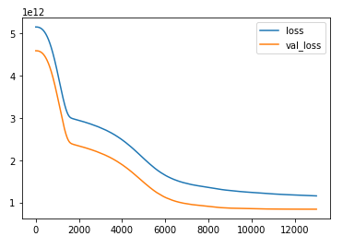
IDEALIZING THE RIGHT PLACE
MSE Evaluation of the Model
OPERATION TYPE: SELL

Slide 53
TRAINING AND LIMITATION
Dataset from the latest listings, February 2018
Removing Outliers: Narrowed to Apartments and the state of Rio de Janeiro
Fine-tuned to showcase the south-eastern coastline trend
Trained to 6000+ Apartment listings
Forecasted possible new real-estate with promising results
OPERATION TYPE: SELL

Slide 54
SCALING UP AND POTENTIAL
Adding a time dimension for a time series analysis
Using a more powerful platform unlocks the data extraction limitation
More training time for using of larger amounts of data
Result: Improving the overall customer experience with accurate forecasts
OPERATION TYPE: SELL

Slide 55
CLOSING

Slide 56
SUMMARY OF INSIGHTS
The south-eastern coastline trend of Rio de Janeiro. Increasing both apartment and housing volume, size, and price as it approaches the area.
Apartment: Paraná is the best state for buying apartments in terms of getting the most spacious with the least amount of money.
The existing seasonality trend of both apartment and housing markets, an inconvenience for short-term perspective and tight budgets.
The promising CAGR of Apartment market of 23.26% and the housing market of 21.16%. Negates the seasonal trend in the long run.

Slide 57
RECOMMENDATIONS
Scaling-up the Neural Network Regression will be a promising improvement of customer experience in all forms investments. Idealizing the right place and forecasting the the future value of the real estates.
An apartment in Rio de Janeiro along its south-eastern coastline is the best long-term investment. Partnered with a good CAGR Apartment Market average price per sq. meter, makes the decision more compelling to buy and hold. The only bottleneck of this plan is the purchase to begin with.

Slide 58
THANK YOU!

